Slide 1
Building A Quadcopter in 10 Weeks
To achieve great things, two things are needed: a plan and not quite enough time.
--Leonard Bernstein
Homepage: http://goo.gl/XYwuoy

Slide 2
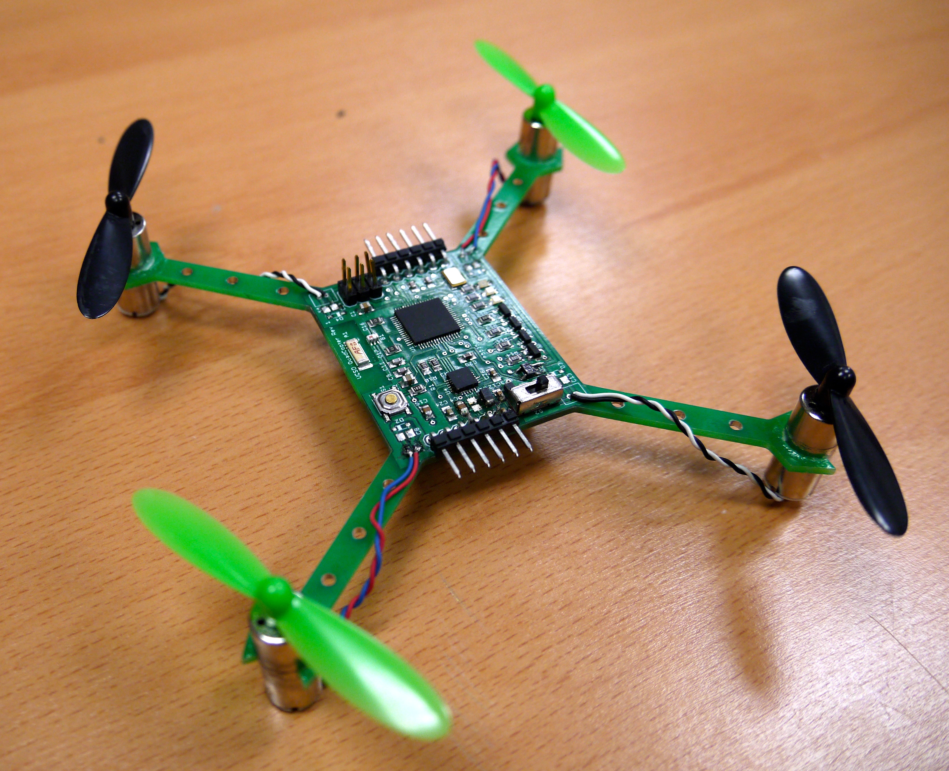
Course Goals
Build several small quadcopter
In 10 weeks
Mostly “from scratch”
Learn
Basic PCB design
How to integrate diverse hardware/software components
About quadcopter-related technologies

Slide 3
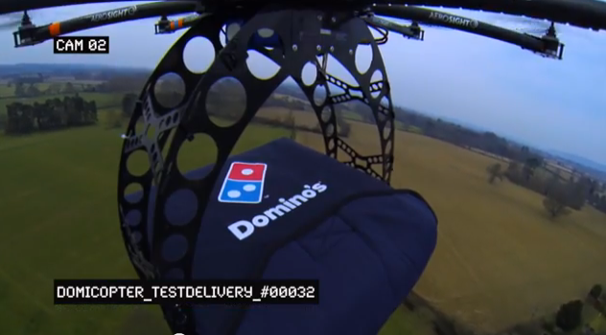
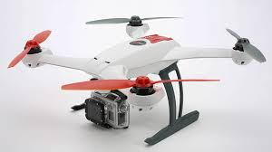
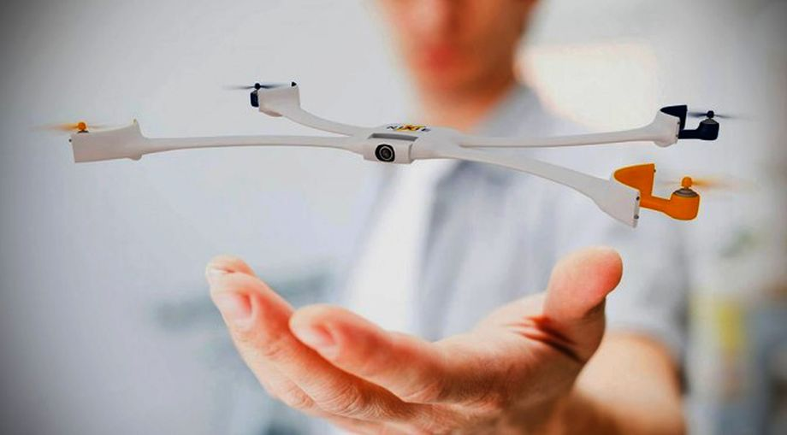
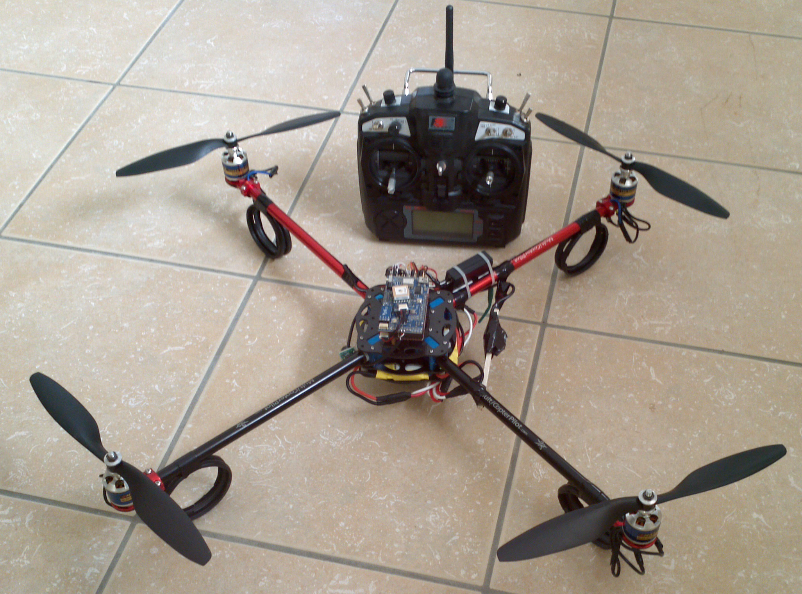
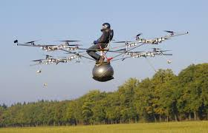
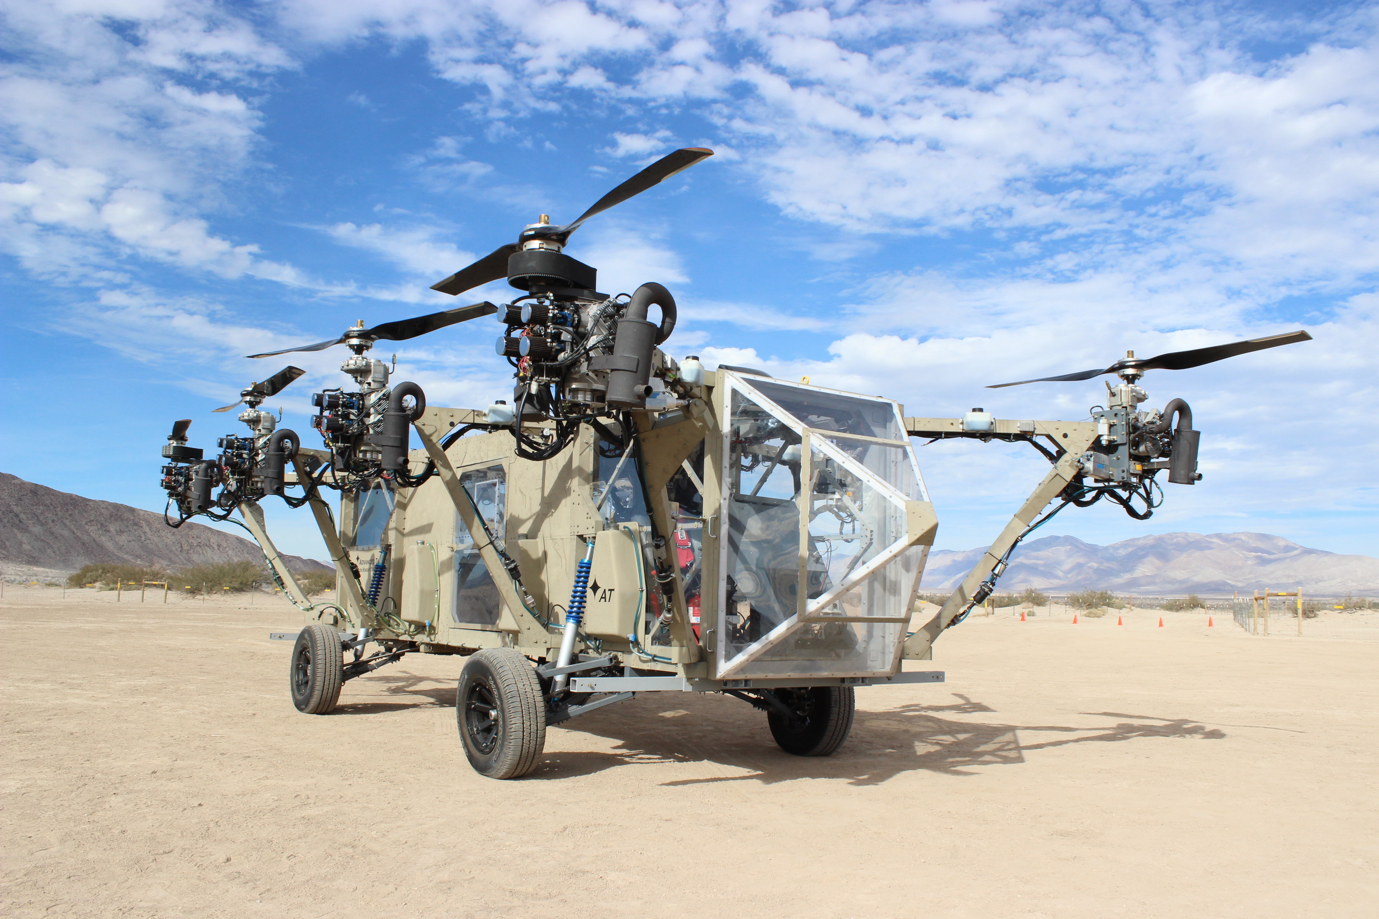
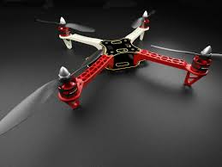
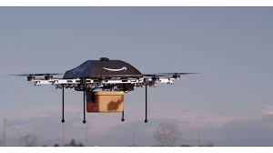
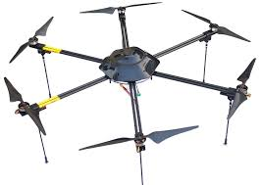

Slide 4
Multirotor Aircraft Components
Airframe
Structural support
Plastic, aluminum, wood, or PCB (fiberglass)
Motors
Lift, movement, and control
Brushed DC motors for small craft
Brushless brushless DC motors for large craft.
Inertial Measurement Unit (IMU)
Sensing the aircraft’s orientation and movement
Gyroscopes and accelerometers.
Computing resources (microcontroller/processor)
To run the flight control software
Manage communication
Flight control software
Provides stability using the IMU and motors
Converts pilot commands to motor outputs
Radio
For receiving command
Returning telemetry.
Power supply
Lots of power for the motors
Carefully regulated power for the IMU and micro controller.

Slide 5
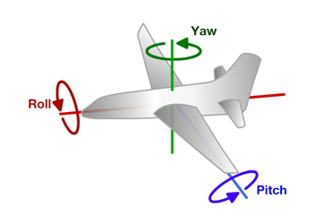
Principles of Operation (1)
An even number of motors provides lift and control in 6 dimensions
Spatial dimensions: x, y, z
Pitch: rotation around left-right (y) axis
Roll: rotation around the front-back (x) axis
Yaw: rotation around the top-bottom (z) axis
A flight computer operates a closed-loop controller to maintain stability and implement pilot commands.
Z
X
Y

Slide 6
Controlling Pitch
Pitch forward
More thrust to the rear
Less to the front
Pitch backward
Less thrust to the rear
More to the back

Slide 7
Controlling Roll
Pitch Left
More thrust to the right motor
Less to the left
Pitch Right
More thrust to the left motor
Less to the Right

Slide 8
Controlling Yaw
Rotate CCW
More thrust to the CCW motors
Less to the CW
Rotate CW
More thrust CW motors
Less to the CCW

Slide 9
Some Possible Configurations
Hexa +
Hexa x
“Plus”
“X”
Octa +
Octa x
“Octothorpe”
Y 6

Slide 10
Maintaining Stability
Multi-rotor aircraft are inherently unstable
Mismatched motor power (voltage variation, manufacturing variation in motors or props)
Variation in air currents and density.
Once perturbed, there’s no force acting on the aircraft to return it to equilibrium.

Slide 11
Maintaining Stability
Multi-rotor aircraft require a closed loop controller
Sensors detect aircraft movement and orientation
Controller adjusts the power to motors to maintain desired location and orientation
Multi-rotor aircraft use a few sensors to maintain stability
Accelerometers (absolute pitch and roll)
Gyroscopes (changes in pitch, roll, and yaw)
The flight computer implements the control algorithm
Usually a proportional, integral, derivative (PID) controller implemented in software.
We will talk more about this later.
With PID controllers for pitch, yaw, and roll multirotor aircraft can achieve stable flight.

Slide 12
Higher-order Navigation
Large multi-rotor aircraft can do more
Maintain geographic position
Maintain altitude
Follow an prescribed/pre-programmed path
More sensors required
Magnetometers (absolute yaw or heading)
GPS (absolute location and altitude)
Barometers (altitude)

Slide 13
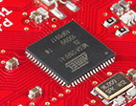
Flight Computer
ATmega128RFA1 microcontroller
Arduino compatible
16Mhz clock
128KB Flash
16KB SRAM
4096B EEPROM
2.4GHz radio (Compatible with Zigbee)

Slide 14
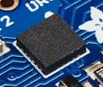
Inertial Measurement Unit
STMicro LSM9DS0
9-axis sensor
3-axis accelerometer
3-axis magnetometer
3-axis gyroscope
I2C interface (more on this later)

Slide 15
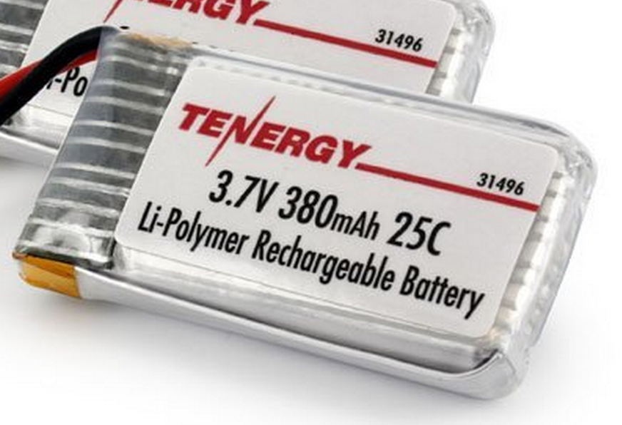
Power Supply
Lithium Polymer Battery
370 Mah
Max 9.25 Amps
Nominal voltage = 3.7V
Powers the motors directly
3.0V low dropout (LDO) voltage regulator
Powers the microcontroller and the IMU
Why 2.7 or 3V instead of 3.3V?

Slide 16
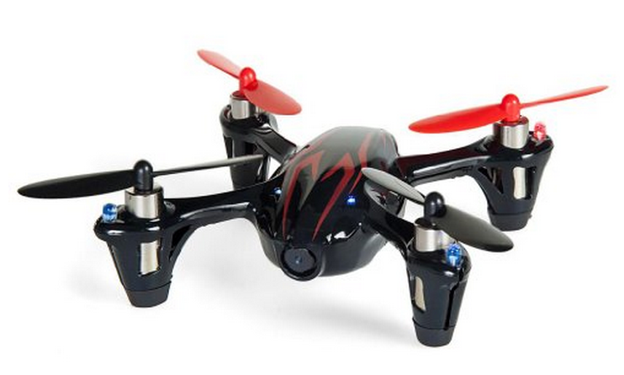
Motors and Props
Suitable motors are hard to find in small quantities.
Correct-fitting props are also a challenge
We will use motors for the Hubsan X4
Purchased as a “crash pack”
Plenty of power
DC brushed motors
They draw ~2A each.

Slide 17
Motor Driver
Pulse-width modulation (PWM)-controlled MOSFET
The microcontroller will drive the MOSFET
The MOSFET will drive current to the motor.
A diode handles the inductive load from motor when it’s off.

Slide 18
Wireless Communication
We will use a custom (i.e., designed by you) communication protocol between the controller an the quadcopter.
Why not one of the existing alternatives?
Standard RC radio protocols are analog or closed source.
Zigbee is complex and closed source.

Slide 19
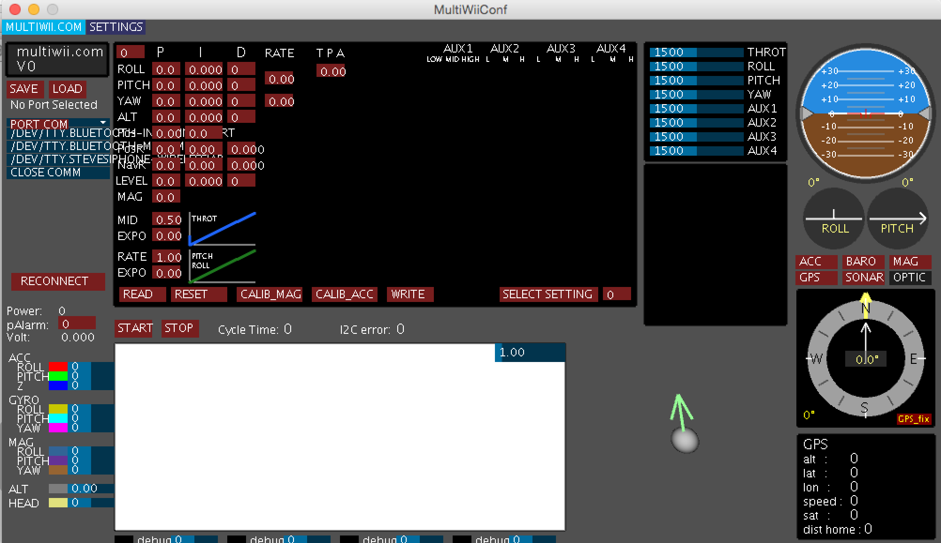
Flight Control Software (Option 1)
Use the MultiWii flight controller software
Open source
Arduino-compatible
Widely used
A GUI
(but not with out it’s idiosyncracies)
You’ll implement the PID controller.

Slide 20
Flight Control Software (Option 2)
Write it from scratch
We will still use the GUI

Slide 21
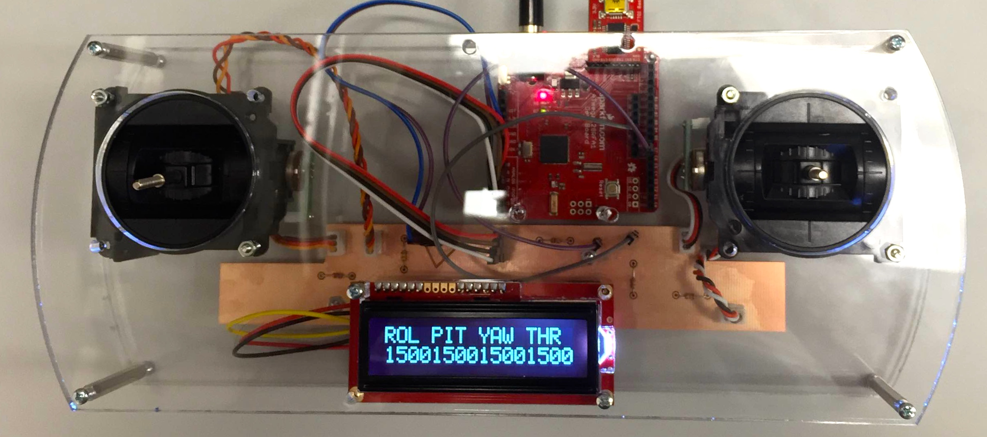
Controller
The controller sends commands to the quadcopter via the radio.
We have a controller design ready for you
It uses the same microcontroller we are using
You’ll be able to customize it a bit.

Slide 22
What You Will Build

Slide 23
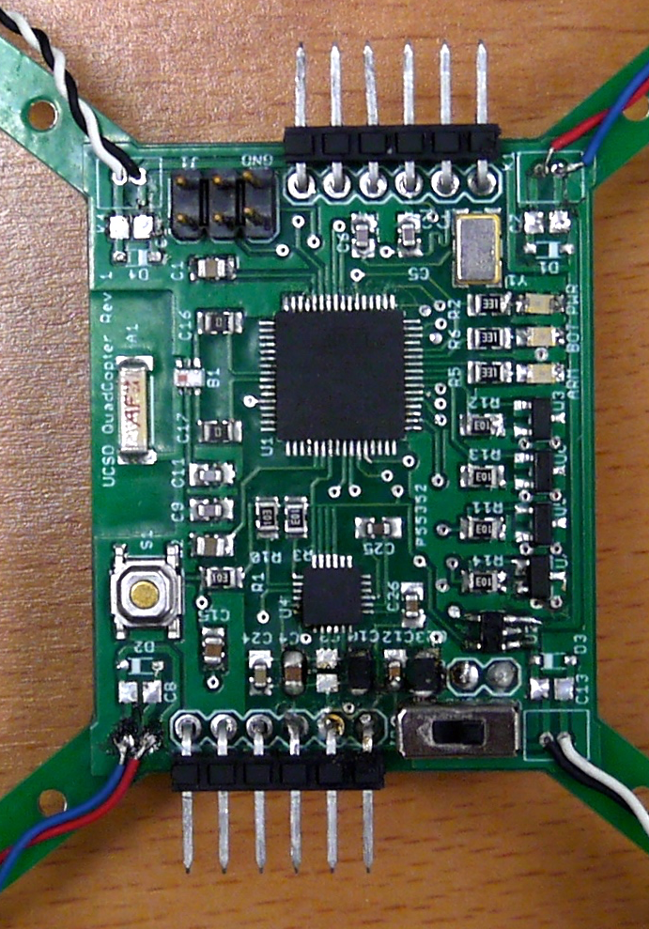
What You Will Build

Slide 24
Lab Overviews

Slide 25
The Lab Schedule
The lab schedule is very aggressive
Preparatory labs (1-4): 2.5 weeks
There’s a new lab each class, and they are due one week later.
You will learn all the skills you need to build the quadcopter
Design and manufacturing labs (5-8): 4 weeks
Design the schematic and board
Manufacture them.
Make it work labs (8-9): 3.5 weeks
Make it fly!

Slide 26
Lab Structure
Labs are divided into hardware and software labs
Hardware labs require equipment
We will provide it.
You are responsible for it (see policy on course web site)
You can take it home to work on it.
Software labs require only software and data

Slide 27
Teams
You will work both in groups and on your own
Lab 1 will be done in pairs of my choosing.
You may not complete part of the lab without your partner present
Labs 2 will be completed on your own.
Labs 3-9 will completed in pairs/groups of your choosing.
In all cases, you can help each other out
No direct copying of source code, designs, etc.
Asking questions, etc. is great.
There is no curve in this class – no need to compete.

Slide 28
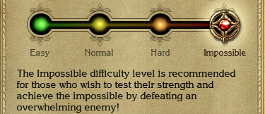
Choose Your Workloads
There are two different paths
“Easy”: Use more pre-built stuff
“Hard”: Use less pre-built stuff
Once you choose, you are committed.
Groups of > 2 must do “hard”

Slide 29
Lab 1: Wireless Communication
Hardware Lab
Learn how to use the microcontrollers
Arduino IDE
The microcontroller breakout boards
The radios
Experiments
Measure bandwidth, error rate, and range

Slide 30
Lab 2: Learn to Use Eagle
Software Lab
Build design a simple schematic.
Turn it into a board design.
Generate manufacturing data.
Performance manufacturing checks.
Design some new parts for the Eagle library.
Learn to decorate your boards.

Slide 31
Lab 3: Other Quadcopter Components
Hardware Lab
Use the remote control to measure gimbal position
Transmit it to the other red board and control a motor accordingly
Read values from an IMU.
Hard: Write some flight control “utilities”

Slide 32
Lab 4: Practice Using Eagle
Software Lab
Build more parts in Eagle.
The IMU
Some discrete components
Hard: Build all the parts.

Slide 33
Lab 5: Start Designing the Quad
Software Lab
Create the schematic
Start with the breakout board schematic.
Connect the IMU
Connect the motor controller
Assemble the power supply circuit
Followed by design review

Slide 34
Lab 6: Flight Control Software
Hardware Lab
Implement PID control
Test on cantilever rig
Easy: Integrate into MultiWii
Hard: Write the rest of the flight control software.

Slide 35
Lab 7: Layout the Board
Software Lab
Define the board outline.
Place your parts.
Route the design.
Followed by design review.
Design review

Slide 36
Lab 8: Tape Out!!!
Software Lab
Your designs must be ready for manufacturing by midnight on May 10.
It will take about a week to manufacture them.

Slide 37
Lab 9: Assembly and Bringup
Hardware Lab
Solder everything to the board
This is non-trivial. The Microcontroller and IMU are challenging packages.
Install the bootloader
Test all the quad subsystems
IMU
Motors
Power
Radio
Debug, Debug, Debug.

Slide 38
Lab 10: Make it Fly!!!
Software and Hardware Lab
Test, adjust, tweak, debug, etc. until its flight is stable.

Slide 39
Logistics

Slide 40
Lab Materials
We will distribute lab materials via github classroom.
You’ll need a github account.
You’ll need to know how to use git.
To access the lab materials, click on the invitation link included in each lab.

Slide 41
Grades and Stuff
No final or exams.
10 Labs
Grading breakdown
50% class participation
50% labs

Slide 42
This is an Intensive, Hands-on Class
Not so much lecturing
Lots of doing.
Your Task
Work Hard
Figure stuff out
Take the initiative
My and Jorge’s Task
Provide high-level guidance
A few lectures
Make sure you have what you need to succeed.

Slide 43
Lab Space
We will meet and work in this room (EnVision -- SME)
Lab hours
3:30-5 on Tuesday and Thursday
Other times TBD

Slide 44
Printed Circuit Boards

Slide 45
Preliminaries
Units
We will use mm in this class.
Lots of tutorials, documents, etc. use mils (1/1000 of an inch) or inches.
1mm is about 40mils (39.3700787, actually)
Keep an eye on your units.

Slide 46
PCBs are Made of Layers
Silkscreen – documentation labels
Metal – for making wires
Dialectric – insulation and structure
Solder mask – protective outer coating

Slide 47
Metal Layers
The Metal layers for several components
Conductive “traces” to connect components
Pads for attaching/connecting components
N-layer boards have N metal layers
N usually is 2,4,...
Fewer layers → cheaper
Top and bottom layers are for mounting components and routing traces
Internal layers can serve several purposes
Ground and power planes
Other signal planes
Internal routing layers

Slide 48
Metal Layers (cont.)
Thickness is measured in oz per square foot.
Standard copper is 1oz
About 0.034 mm
Thicker metal layers can carry more current

Slide 49
Dielectric
The dielectric in the insulator between metal layers
Most PCBs use FR4
“glass reinforced epoxy laminate”
i.e., fancy fiberglass
“FR” means “flame retardant”
Other specialized dielectrics are are available
To support high speed circuits
To manage thermal expansion

Slide 50
Solder Mask
The solder masking is a polymer (plastic) coating on the top and bottom of the board
Solder does not adhere to it.
It serves several needs
Protects the top and bottom metal from oxidation.
Helps prevent solder bridges

Slide 51
Silkscreen
It’s an opaque (usually) white epoxy
It provides documentation and markings
References designators
Part outlines
Logos
Serial numbers etc.

Slide 52
Making Connections Between Layers
Plated holes connect metal layers.
Drill a hole
Electroplate it with copper
The plating attaches to metal that the hole passes through

Slide 53
Pads and Vias
Vias are electrical connections
Usually very small.
Through hole pads accommodate through-hole parts
Even larger, mounting holes are possible

Slide 54
Designing Through-hole Pads
The diameter of the hole is smaller than the drilled hole
You need to add about 0.1-0.3 mm to the desired, plated internal diameter to get the drill diameter
More here: http://goo.gl/NzcY2W

Slide 55
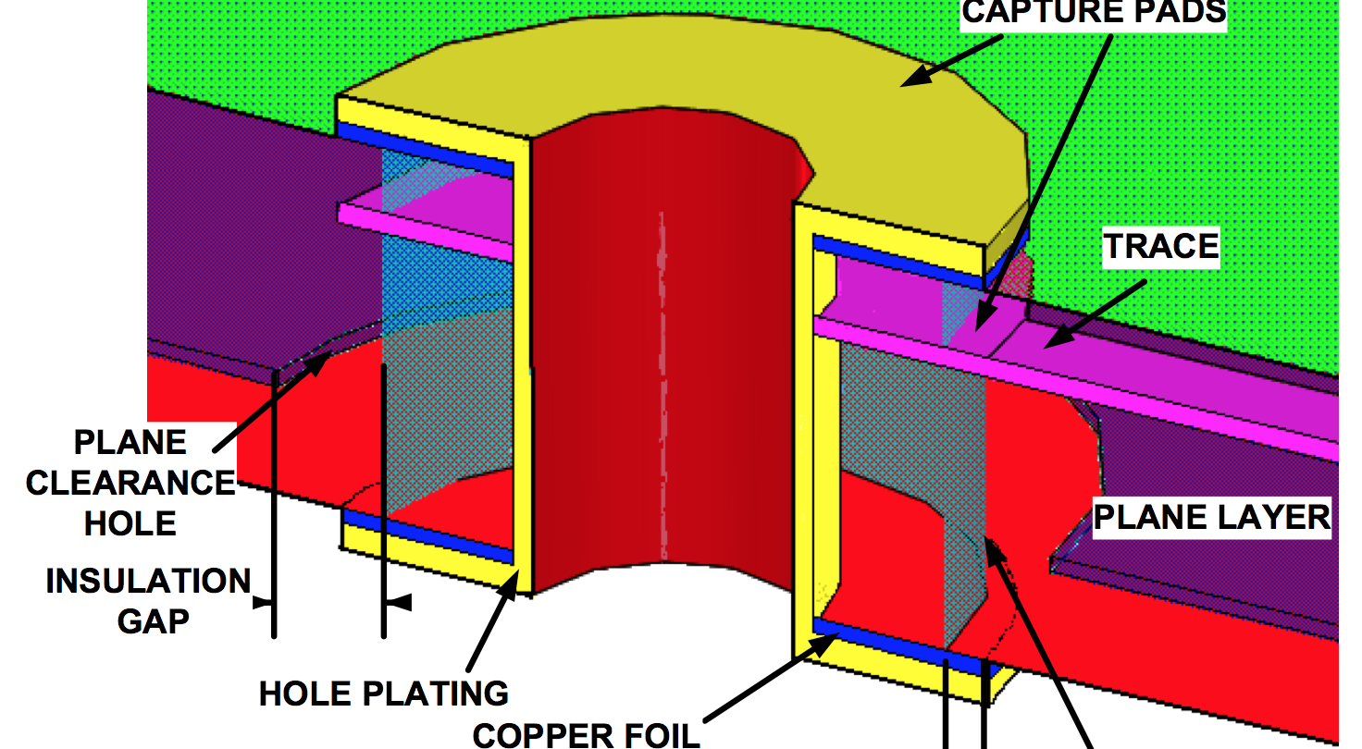
Holes and Vias

Slide 56
Lots of Choices, in Theory
There are many, many choices when designing a PCB
We will get to make very few of them
Cheap, quickturn PCB manufacturers provide a standard setup. E.g.:
FR4
1oz copper
2 or 4 layers

Slide 57
Resources
White paper about board stackups
www.icd.com.au/articles/Stackup_Planning_AN2011_2.pdf
Videos of PCB Manufacturing
This one is very good and really thorough, but it’s too long to watch in class.
https://www.youtube.com/playlist?list=PL8zP8UuDk8a0ZNWiteC-7PHx1HCeBY0qB

Slide 58
Lab 1: Learning Arduino

Slide 59
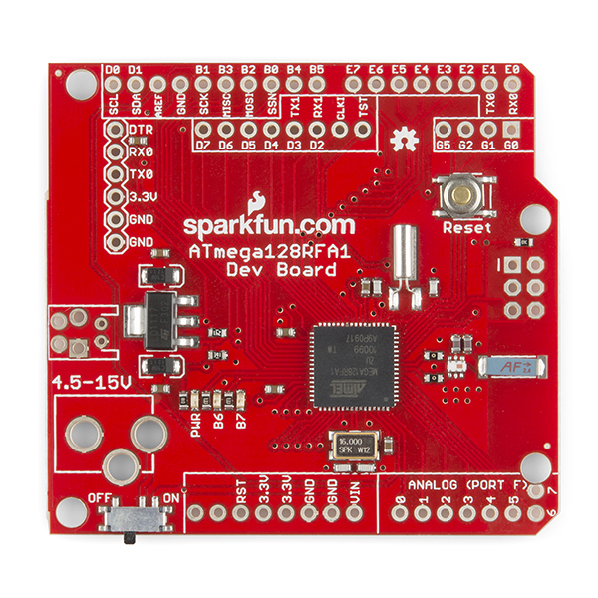
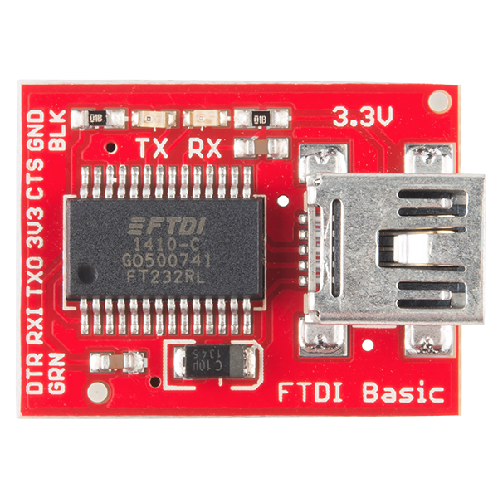
The Red Board
Nice breakout board for our microcontroller
Open source
Working radio design
Well-documented
Arduino compatible
Programmable with FTDI USB-to-serial converter
Key component of the controller
Reference design for the quadcopter’s flight computer and radio.

Slide 60
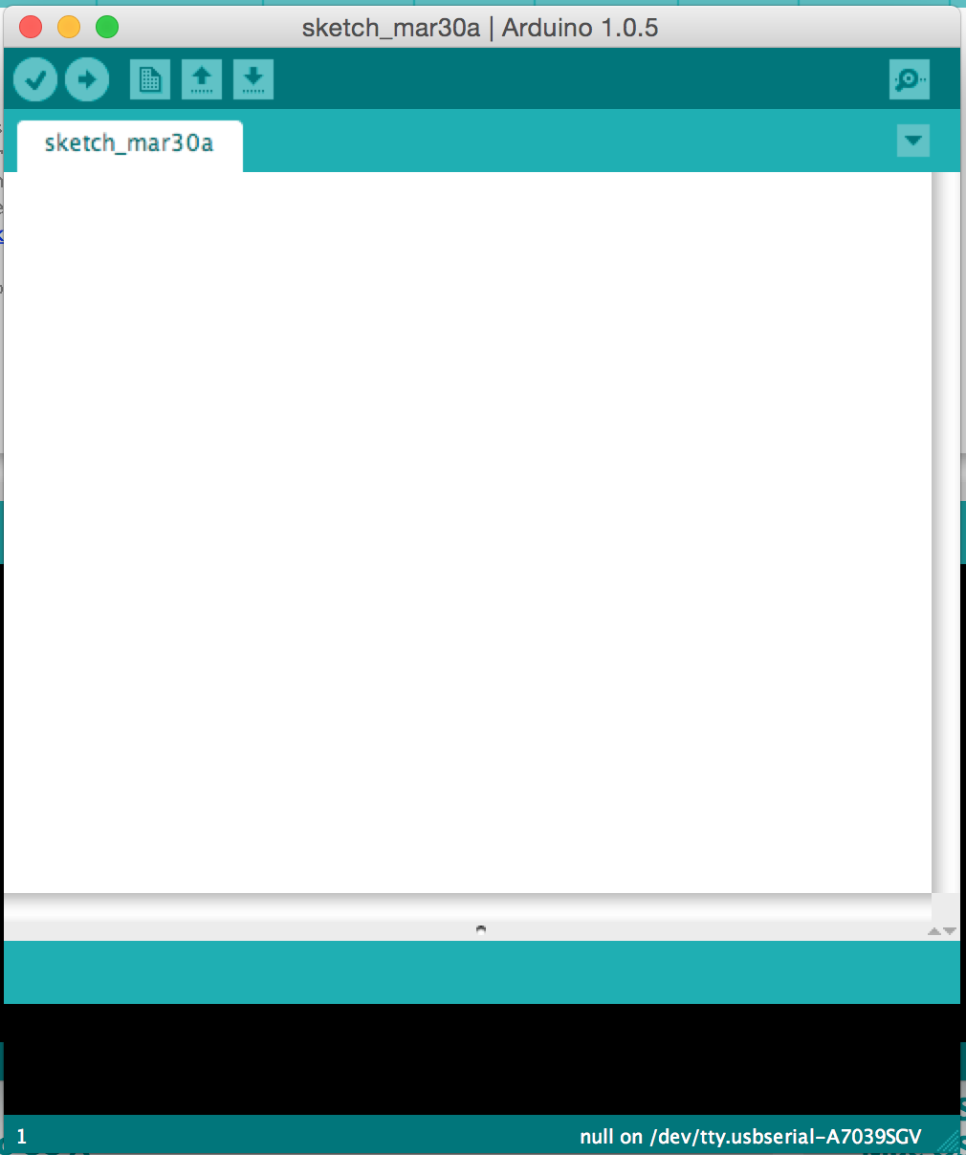
The Arduino IDE
User-friendly IDE for Arduino programming
Programming the microntroller is easy
Installation is easy
Alternatives
Eclipse for Arduino
Official AVR tools from Atmel
You can use them, but they aren’t supported by us.

Slide 61
Tasks
Get wireless working
Download, compile, and install a simple chat program that runs between two red boards.
Push its limits
Do some simple experiments to
Measure range, bandwidth, and the error rate

Slide 62
Lab 1 Kit
1x red boards
1x Remote control
2x FTDI
2x USB cable

Slide 63
Get Started!!!

